Slide 1
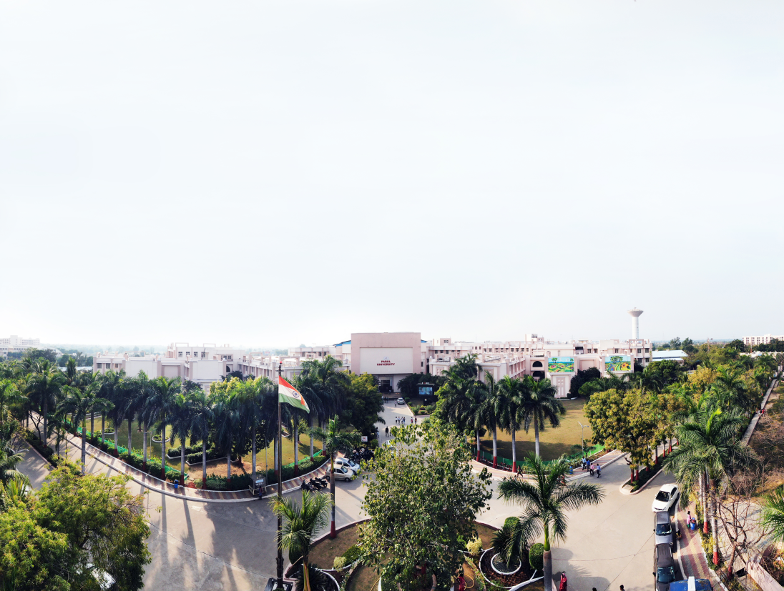

Proposed Ph.D. Title: BERT based Twitter sentiment analysis for Gujarati Language pre-processing evaluation
DRC No.: 01
Date of Registration:08/02/2024
Enrollment No.: 23230041640012
Submitted by : Manish Kumar Joshi
Supervised by : Dr. Mukesh Choudhary
Name of Faculty: Faculty of IT & CS

Slide 2
Introduction
Sentiment Analysis aims to determine the polarity of emotions like happiness, sorrow, grief, hatred, anger, and affection and opinions from text, reviews, and posts, which are avail able in many media platforms [1]. Sentiment analysis helps in tracking people’s viewpoints. For example, it is a powerful marketing tool that enables product managers to understand customer emotions in their various marketing campaigns. It is an important factor when it comes to social media monitoring, product and brand recognition, customer satisfaction, customer loyalty, advertising and promotion’s success, and product acceptance. It is among the most popular and valuable tasks in the field of NLP [2].
Blogs, micro-blogs, social networks and all these types of websites are a massive source of information for many analysts, entrepreneurs and politicians who aim to expand their business by exploiting the large amount of text generated by users who give constant and continuous feedback on the visibility of a given subject through feelings, opinions and reviews [1].
In recent years, significant results have been obtained by developing several methods, starting from those based on the creation of rules [6], through those based on machine learning [7], and finally to those based on deep learning [8], which currently represent the state-of-the-art.

Slide 3
Introduction
Despite the excellent results achieved, the performance of current systems is strictly correlated to the specific language considered(E.G Urdu, French, German, English), but while we are considering reginal language like Gujarati, There is limited work has been done yet.
The aim of this proposal is to develop a robust framework for sentiment analysis of Twitter data using BERT (Bidirectional Encoder Representations from Transformers), focusing on Gujarati language pre-processing evaluation.
In the field of sentiment analysis of tweets, most of the scientific literature has obtained state-of-the-art results adopting the approach of training language models directly from scratch starting from corpora made up exclusively of tweets, so that the models could better handle the specific tweet jargon, characterized by a particular syntax and grammar not containing punctuation, with contracted or elongated words, keywords, hashtags, emoticons, emojis and so on.

Slide 4
OBJECTIVES OF RESEARCH WORK
Collecting Diverse Gujarati Language Twitter Dataset
Exploring Gujarati Language Pre-Processing Techniques
Fine-Tuning BERT Models for Sentiment Analysis
Evaluating Performance Across Languages
Comparative Analysis with Baseline Models

Slide 5
Literature review of proposed methods
Literature Review of Proposed Methods

Slide 6
Summary of Literature Review
Comparative analysis of related work.

Slide 7
Research Gap
To investigate the specific contributions of each pre processing procedure, as well as other settings associated with the tuning, so as to further characterize the language model for the purposes of sentiment classification. Moreover, possible future extensions of this work include the application of the proposed approach for similar sentiment-related tasks like irony detection and subjectivity classification, in order to validate its effectiveness with particular focus on the pre-processing step. Finally, the proposed approach will also be tested and assessed with respect to other datasets, languages and social media sources, such as Facebook posts, in order to further estimate its applicability and generalizability[1]
future research into combining linguistic insights with deep learning for more sophisticated language understanding[2]
We propose future work to dwell on how to effectively apply accuracy improvement techniques to transformed BERT features despite loss of semantic information in them and focus on how different components of a sentence contribute to its sentiment prediction since this is information that is not generally exploited by current approaches[3].

Slide 8
Research Gap
Future direction of this research includes the employment of the pre-processing procedure individuated here in association with update language models such as RoBERTa, pre-trained on larger corpora including informal text, or with multilingual models, such as XLM-R, to argue more general conclusion on a wider number of different languages[4]
It outperforms existing methods by demonstrating remarkable enhancement sinaccuracyandf-measure, achieving improvements of up to 26.09% and 25.87%, respectively. There are plans to extend the validation of the USA-BERT approach to cover other low-resource languages as well[5]
Future research should explore new meth ods to improve the aspect extraction task as there is still room for improvement. Other methods for optimizing T2 should be investigated. This study contributes to the body of knowledge by enriching research in the Arabic language as well as the educational field. The system can be used by educational institutions to analyze open-ended Arabic responses more efficiently and improve their services and institutions [6]

Slide 9
Research Gap
In our future work, we plan to further improve and refine our techniques in order to enhance the accuracy of our method. Thereafter, we involved to test multilingual WordNet for tweets and to orient this work in a big data environment[7]
Future work will be directed to investigate the specific contributions of each pre processing procedure, as well as other settings associated with the tuning, so as to further characterize the language model for the purposes of sentiment classification. Moreover, possible future extensions of this work include the application of the proposed approach for similar sentiment-related tasks like irony detection and subjectivity classification, in order to validate its effectiveness with particular focus on the pre-processing step. Finally, the proposed approach will also be tested and assessed with respect to other datasets, languages and social media sources, such as Facebook posts, in order to further estimate its applicability and generalizability[8]
It outperforms existing methods by demonstrating remarkable enhancement accuracy-measure, achieving improvements of up to 26.09% and 25.87%, respectively. There are plans to extend the validation of the USA-BERT approach to cover other low-resource languages as well[9]

Slide 10
Research Gap
In future, our plan is to use models such as GPT, GPT2 and GPT3 to improve the results. We believe that our publicly available dataset will serve as a baseline for sentiment analysis in Urdu[10]
The further utilization and qualitative comparison and analysis of the performance of BERT based models specifically trained on Twitter datasets, such as TwHIN and XLM-T, will be one of the key objectives of the future work focusing on the multilingual analysis of tweets[11]
Finally, and due to the seasonal nature of Twitter, it would also be interesting to explore correlations between topic distribution and trends and performance in downstream applications[12]

Slide 11
Tools and Technology
NLTK
Kaggle
Web Scraping

Slide 12
System Flow of Proposed Research Work
Data Collection and Corpus Building
Multilingual Pre-Processing
BERT Model Configuration and Fine-Tuning
BERT Model Configuration and Fine-Tuning
Comparative Analysis and Baseline Models
Practical Applications and Case Studies

Slide 13
Future Work for the DRC
Data Collection and Corpus Preparation

Slide 14
Reference
[1]. Marco Pota 1 ,MirkoVentura 1, Rosario Catelli 1,2,* andMassimoEsposito(2021), AnEffective BERT-Based Pipeline for Twitter Sentiment Analysis: A Case Study in Italian.
[2]. Kamran Aziz 1, Donghong Ji 1*, Prasun Chakrabarti 2, Tulika Chakrabarti 3, Muhammad Shahid Iqbal 4 & Rashid Abbasi 5(2024), Unifying aspect‑based sentiment analysis BERT and multi‑layered graph convolutional networks for comprehensive sentiment dissection.
[3]. Gibson Nkhata(2022), Movie Reviews Sentiment Analysis Using BERT.
[4]. Marco Pota, Mirko Ventura, Hamido Fujita, Massimo Esposito(2021), Multilingual Evaluation of Pre-Processing for BERT-based Sentimental Analysis of Tweets.
[5]. MUHAMMADREHANASHRAF1,2, YASMEEN JANA2, QASIM UMER M. ARFAN JAFFAR1, SUNGWOOK CHUNG 2,3, 4,ANDWAHEEDYOUSUFRAMAY(2021), BERT-Based Sentiment Analysis for Low-Resourced Languages: A Case Study of Urdu Language
[6]. KHLOUD A. ALSHAIKH 1,OMAIMAA.ALMATRAFI 1,ANDYOOSEFB. ABUSHARK(2024), BERT-Based Model for Aspect-Based Sentiment Analysis for Analyzing Arabic Open-Ended Survey Responses: A Case Study

Slide 15
Reference
[7]. Marouane Birjalia,*, Abderrahim Beni-Hssanea, Mohammed Erritalib(2017), Machine Learning and Semantic Sentiment Analysis based Algorithms for Suicide Sentiment Prediction in Social Networks.
[8]. Marco Pota 1 ,MirkoVentura 1, Rosario Catelli 1,2,* andMassimoEsposito(2020), AnEffective BERT-Based Pipeline for Twitter Sentiment Analysis: A Case Study in Italian.
[9]. MUHAMMADREHANASHRAF1,2, YASMEEN JANA2, QASIM UMER M. ARFAN JAFFAR1, SUNGWOOK CHUNG 2,3, 4,ANDWAHEEDYOUSUFRAMAY(2023), BERT-Based Sentiment Analysis for Low-Resourced Languages: A Case Study of Urdu Language.
[10]. Lal Khan1, Ammar Amjad1, Noman Ashraf2 & Hsien‑Tsung Chang(2022), Multi‑class sentiment analysis of urdu text using multilingual BERT.
[11]. George Manias1 •Argyro Mavrogiorgou1 • Athanasios Kiourtis1 • Chrysostomos Symvoulidis1 • Dimosthenis Kyriazis(2023), Multilingual text categorization and sentiment analysis: a comparative analysis of the utilization of multilingual approaches for classifying twitter data.

Slide 16
Reference
[12]. Francesco Barbieri , Luis Espinosa Anke , Jose Camacho-Collados(2022), XLM-T: Multilingual Language Models in Twitter for Sentiment Analysis and Beyond.

